Slide 1
Poems Search Engine
范才勇

Slide 2






Intro

Slide 3
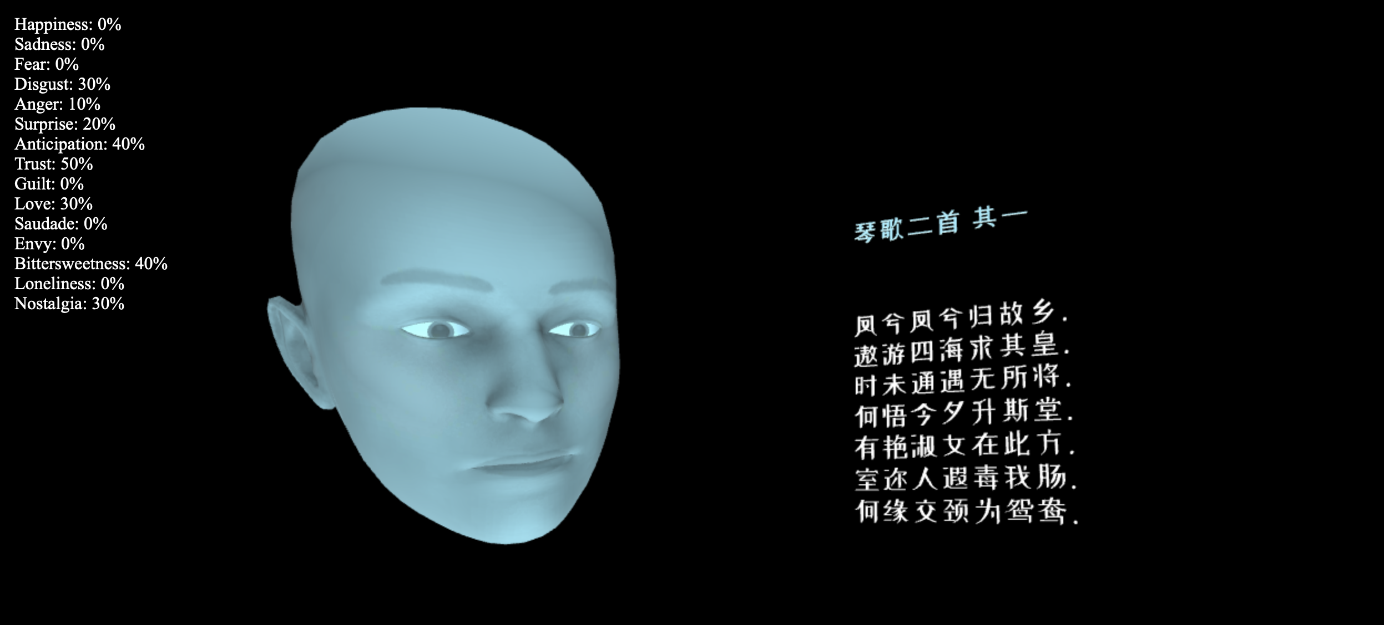
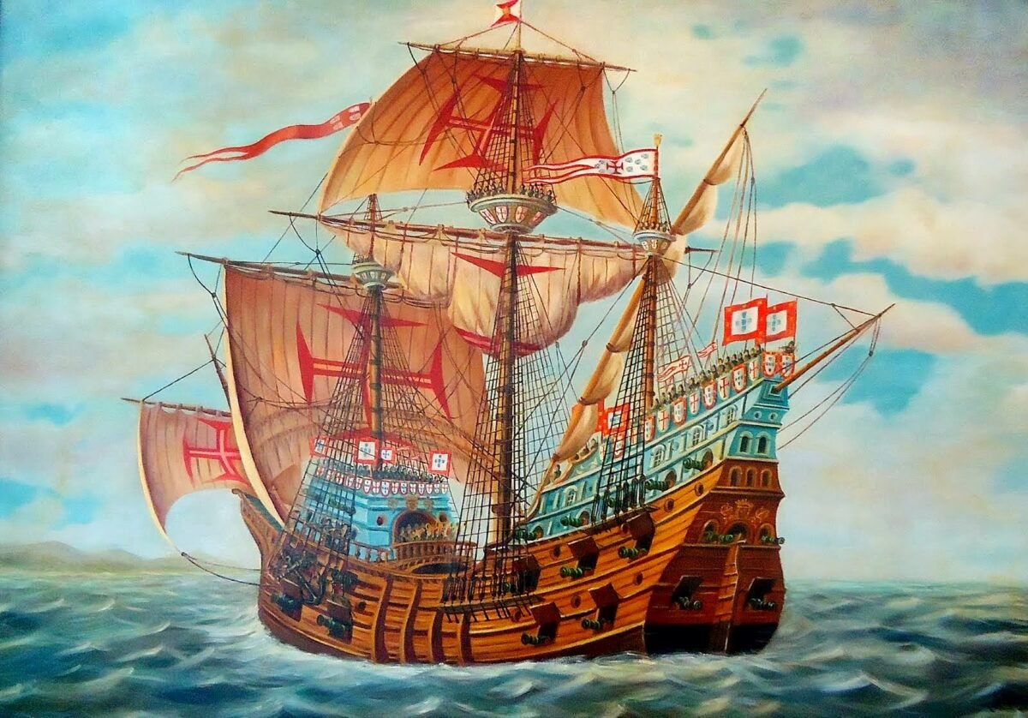
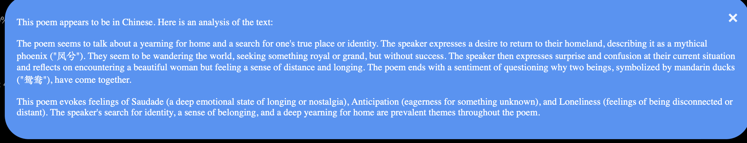
General Idea – Emotion || IR || Poems

Slide 4
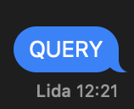
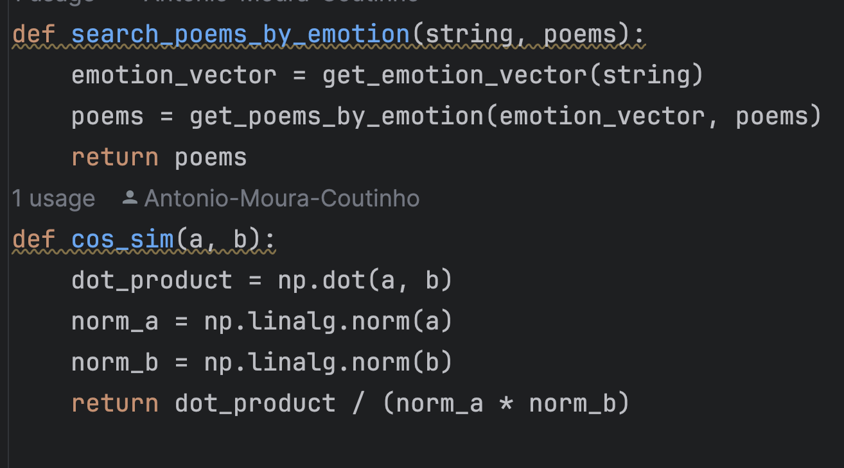
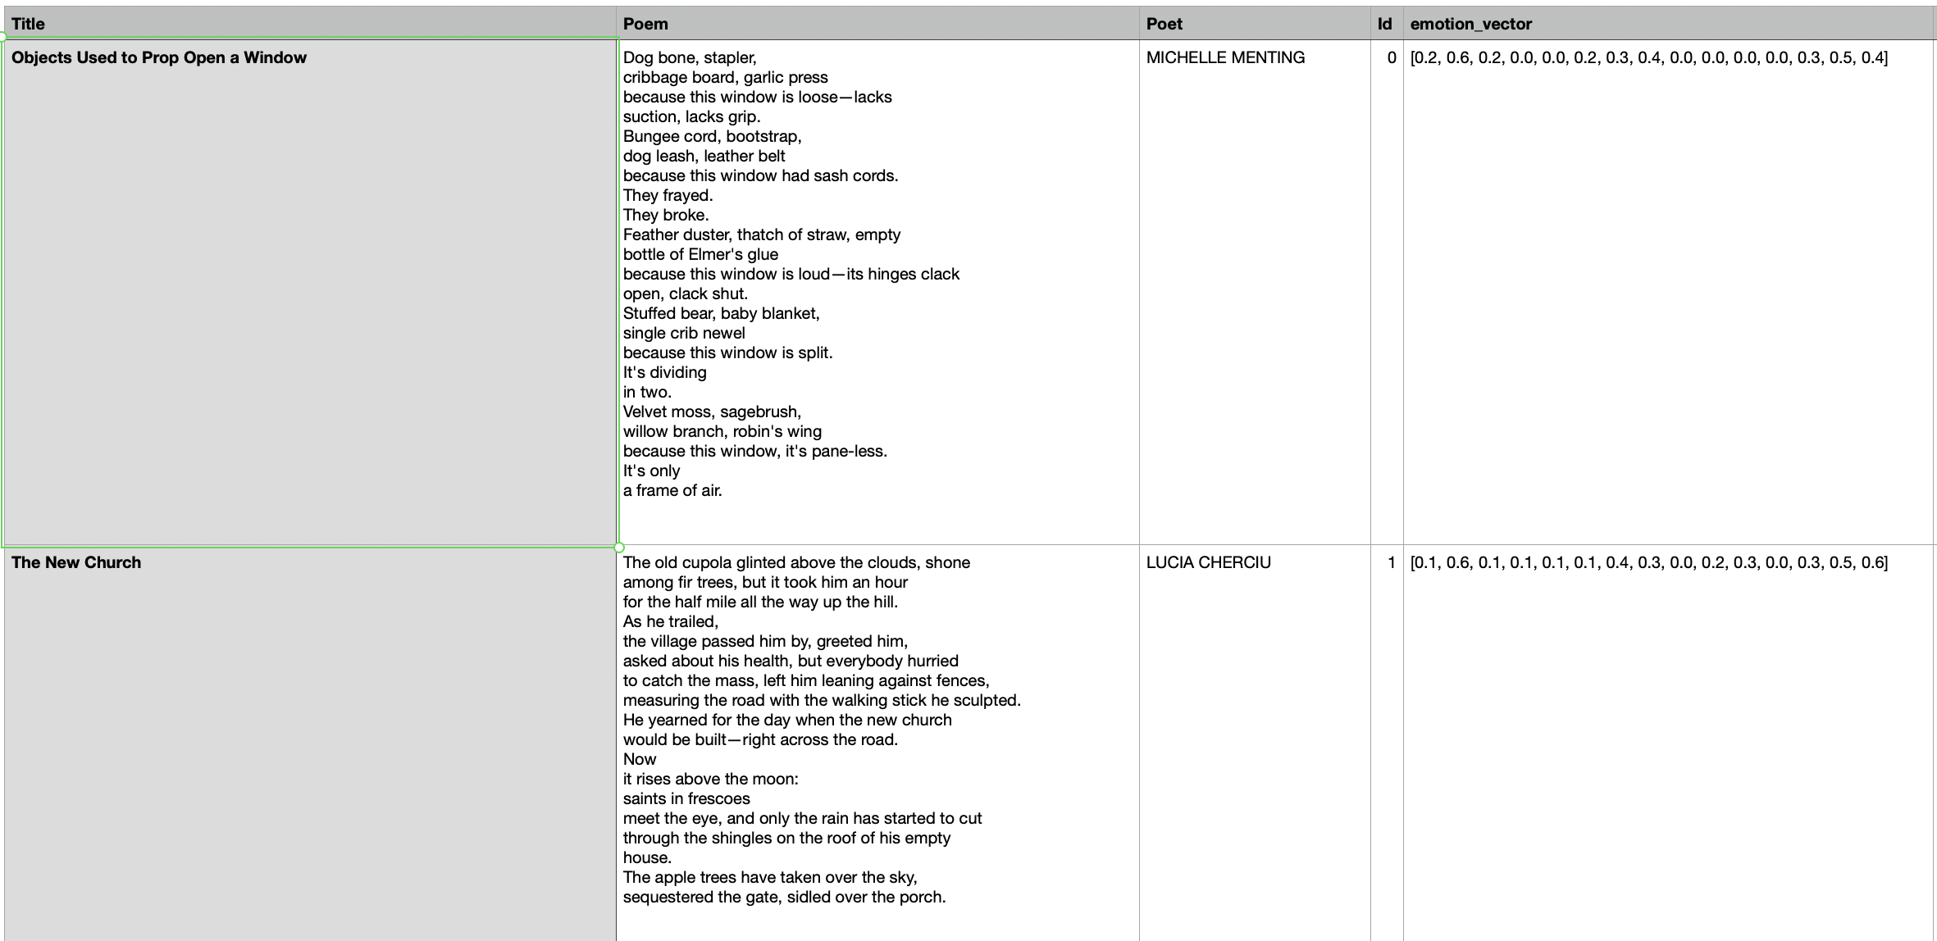
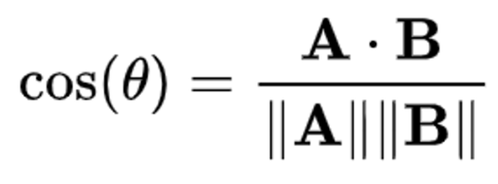
Search engine structure
[
Happiness, Sadness, Fear, Disgust, Anger, Surprise, Anticipation, Trust,
Guilt,
Love, Saudade, Envy, Bittersweetness, Loneliness, Nostalgia
]

Slide 5



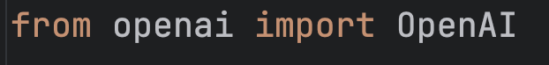


BACKEND

Slide 6




Data retrieval , and cleaning ...
POET POEM TITLE EMOTION VECTOR ID
>10 000 lines (poems) tang

Slide 7


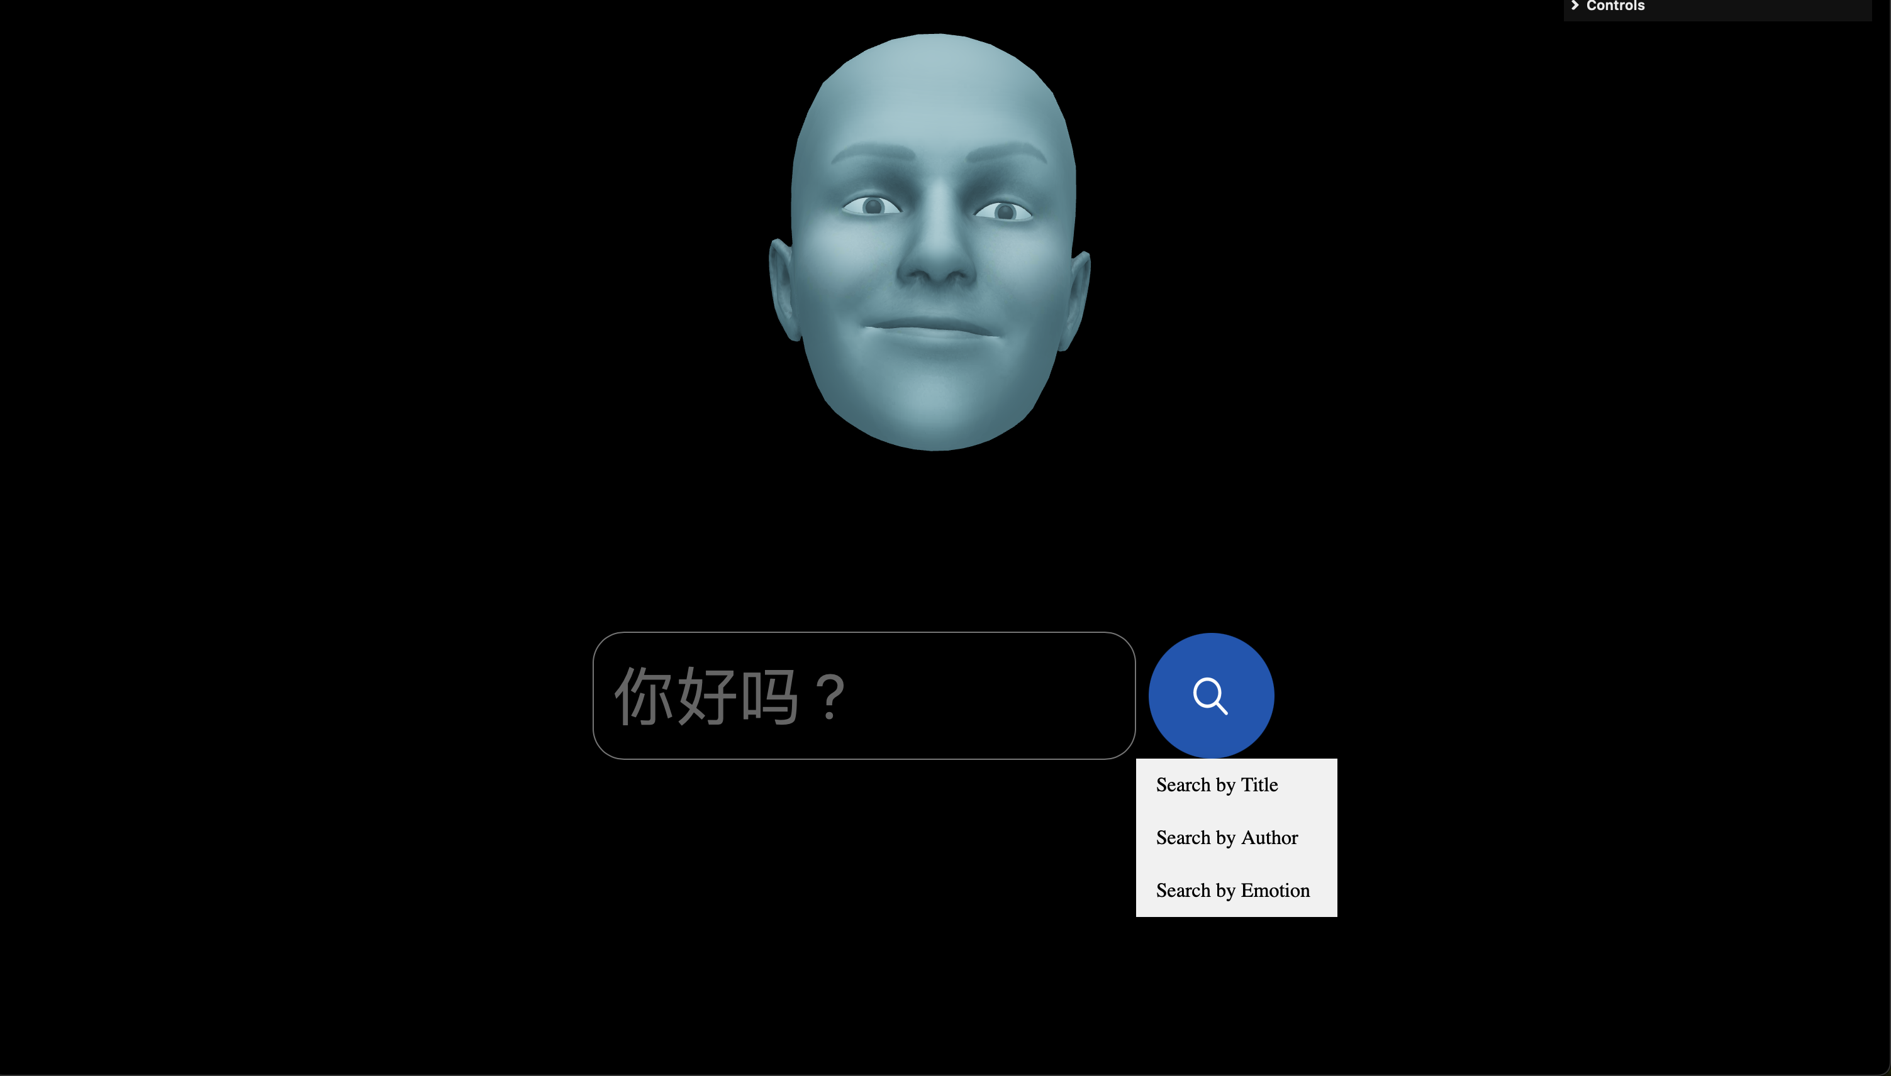
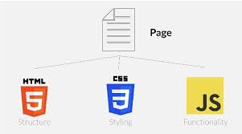
frontend

Slide 9
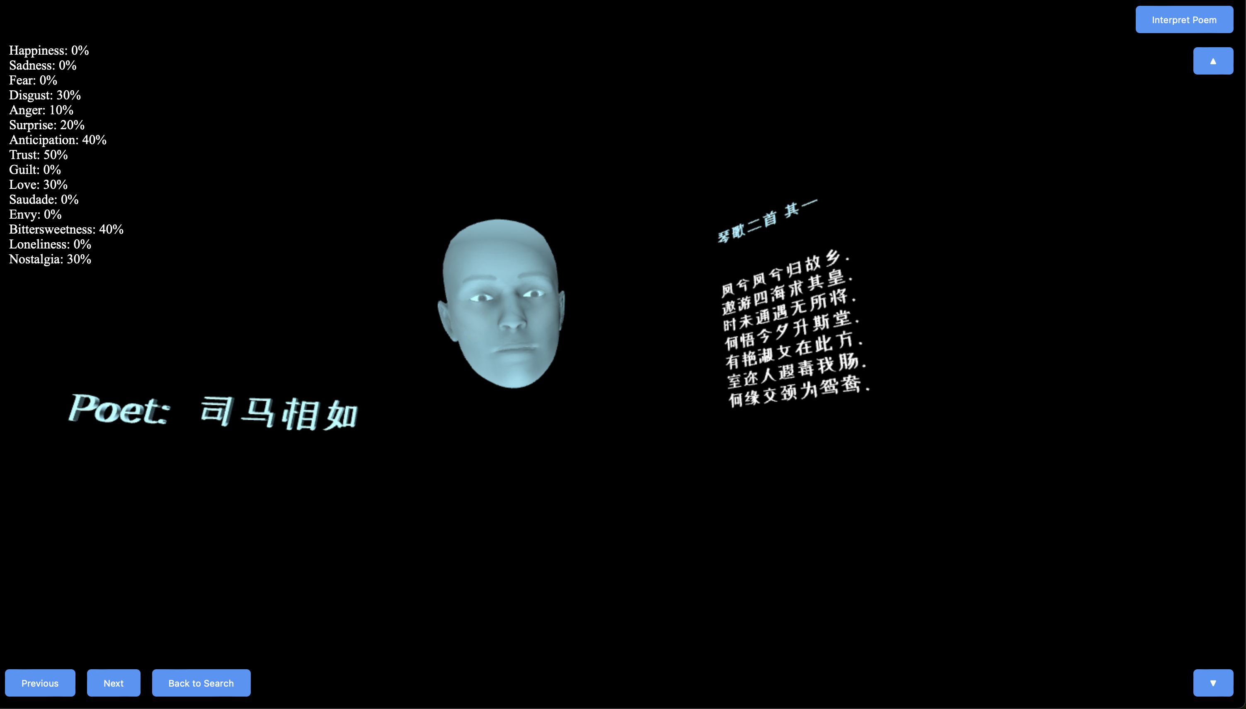

Slide 11
Future ideas and improvements
Improve classifier
Improve search , more filters like language etc
Better UI
General Speed of webApp

Slide 12
demo

Slide 13
Questions ☺ ???

